Slide 1

Fundamentals of Machine Learning
JETANGI LOKESH

Slide 2
Agenda
1
2
3
4
5
Introduction
objective
Data description
Analysis of Clusters
conclusion

Slide 3
Introduction and Data Preprocessing
Overview of data: Monthly fuel contracts, purchases, and costs with 30 variables
Data cleansing: Removed variables with missing and redundant data for effective analysis
Sampled data: 2% of the data from 608,565 rows using a seed (1234)
Data split: Divided into training and testing sets with 75% and 25% respectively
Output: 9000 training sets and 3000 test sets obtained for analysis

Slide 4

Objective
To examine the monthly fuel contract data, purchases, and prices associated with US energy statistics.

Slide 5
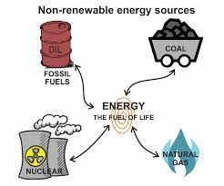
DATA DESCRIPTION Variables used to analyze the Data:
.
Fuel received units
Contract type code
Fuel MMBtu per unit
Energy source code
Sulfur content pct
Fuel group code
Mercury content ppm
Primary transportation mode code
Fuel cost per mmbtu
Fuel type code PUDL
Ash content pct

Slide 6
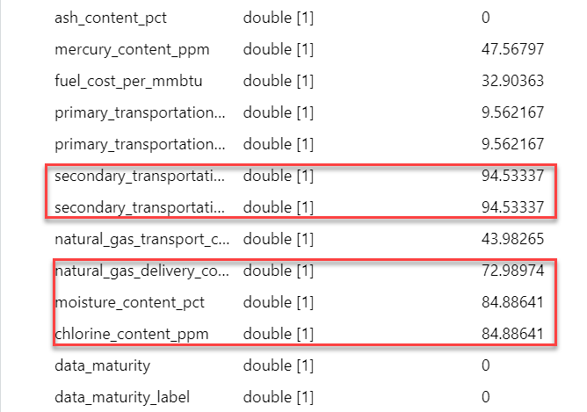
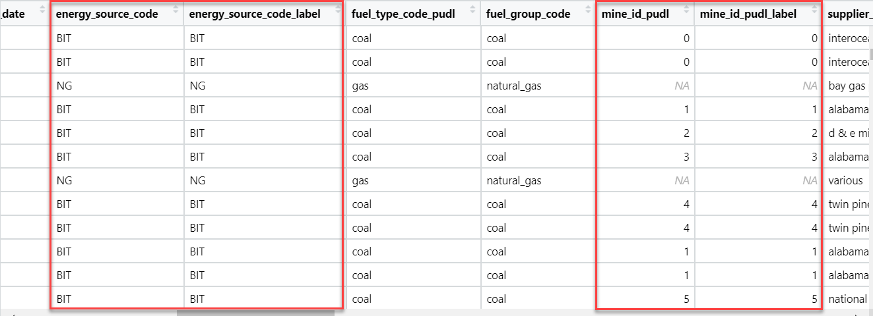
DATA DESCRIPTION Reasons for not considering certain Variables:
1. Missing values: Excluded variables having more than 50% missing values.
2. Redundant data: Ignored variables which has same data as another variable.

Slide 7
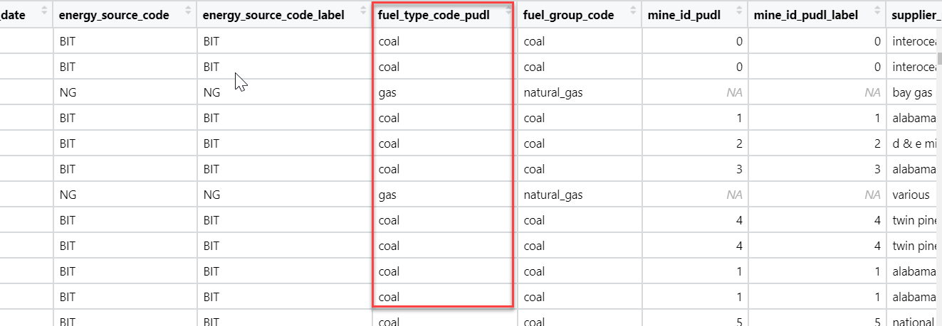
DATA DESCRIPTION The key variable used for data analysis:
Fuel type code PUDL
Coal
Gas
Oil

Slide 8
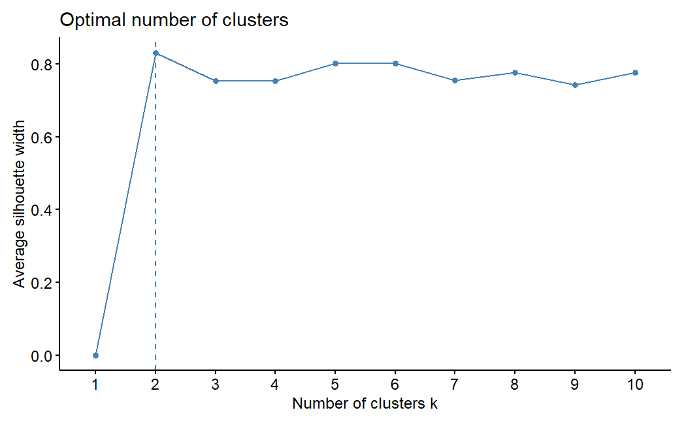
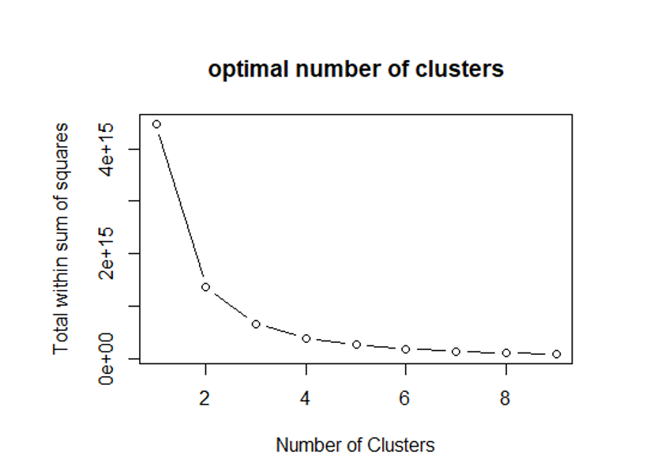
Elbow chart and the Silhouette Method

Slide 9
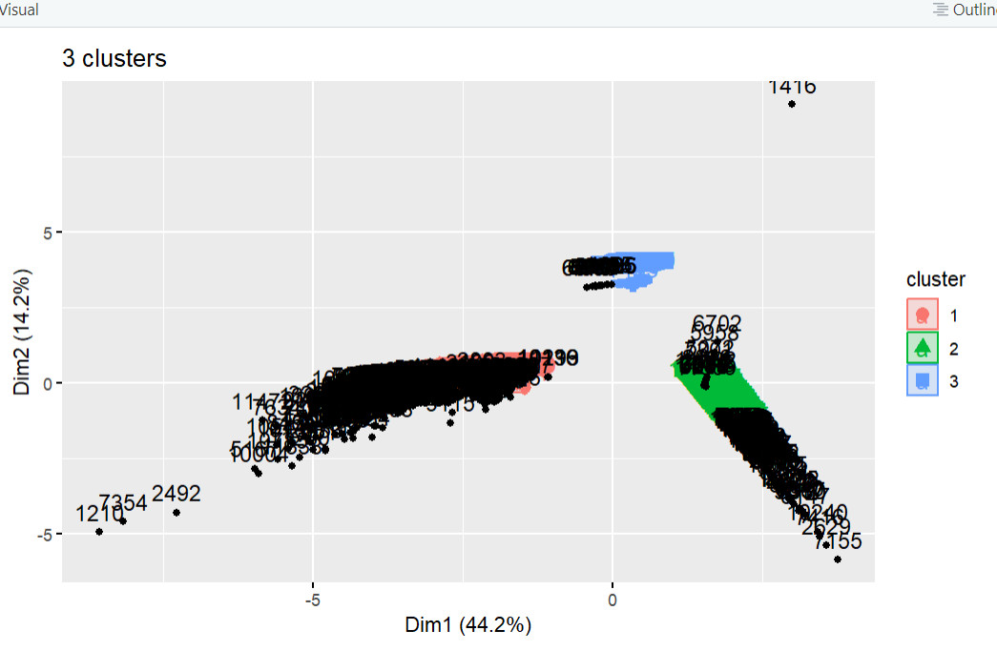
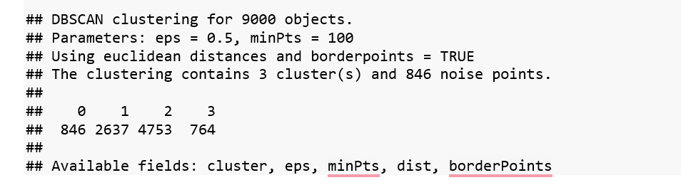
Data clusters
DBSCAN algorithm is used to form clusters in order to draw meaningful insights about U.S. energy.
DBSCAN is known to be the best algorithm that handles outliers and noisy data.
Why DBSCAN?
`

Slide 10
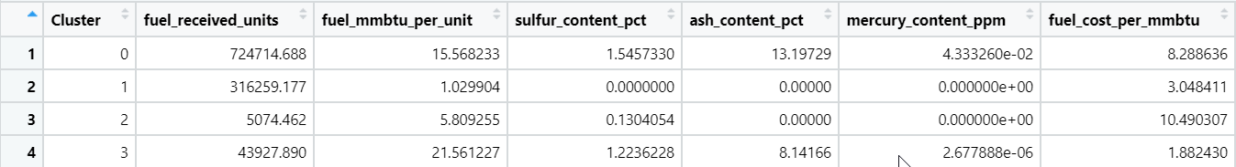
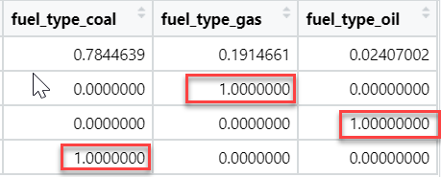
Findings from Clusters:
Names of each cluster:
1st Cluster : Gas
2ndCluster : Oil
3rdCluster : Coal

Slide 11
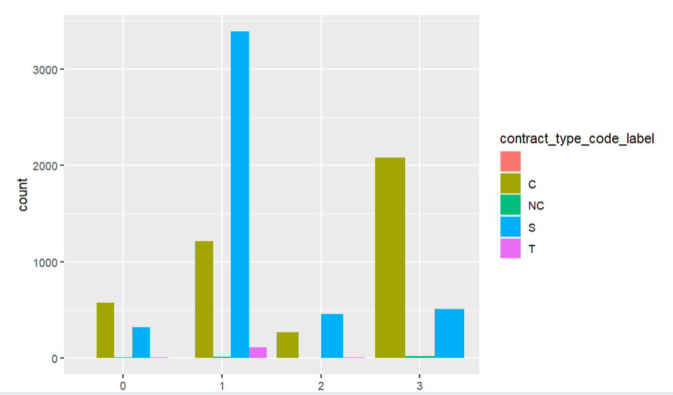
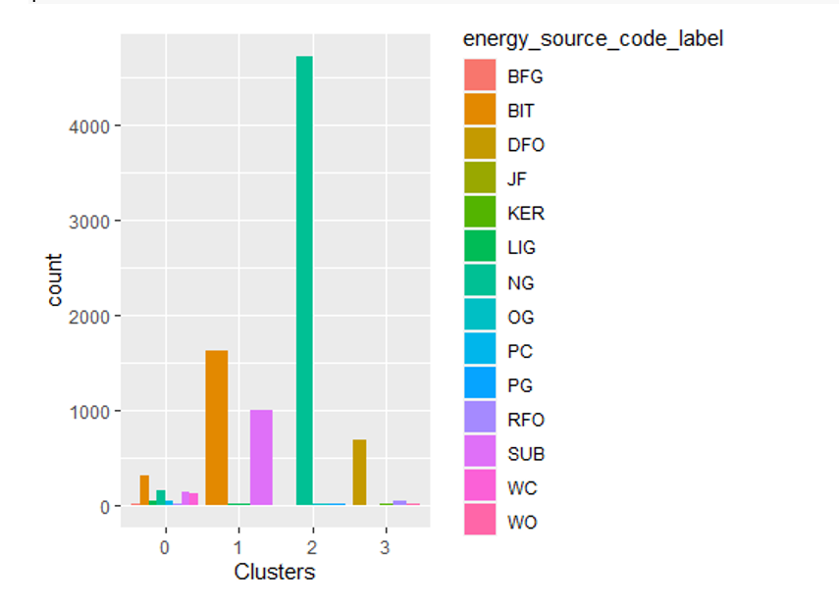
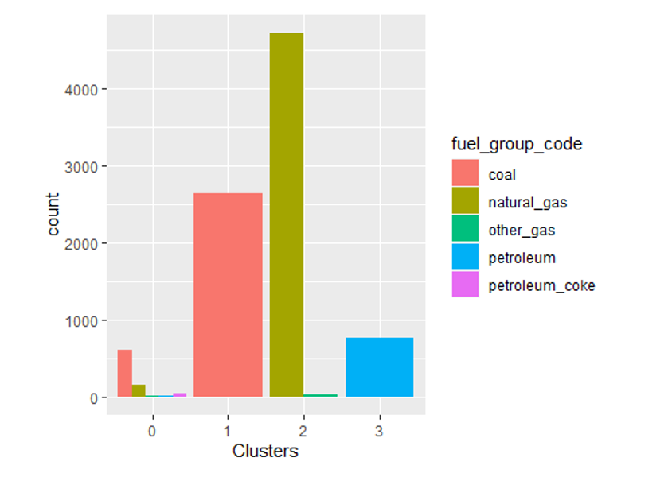
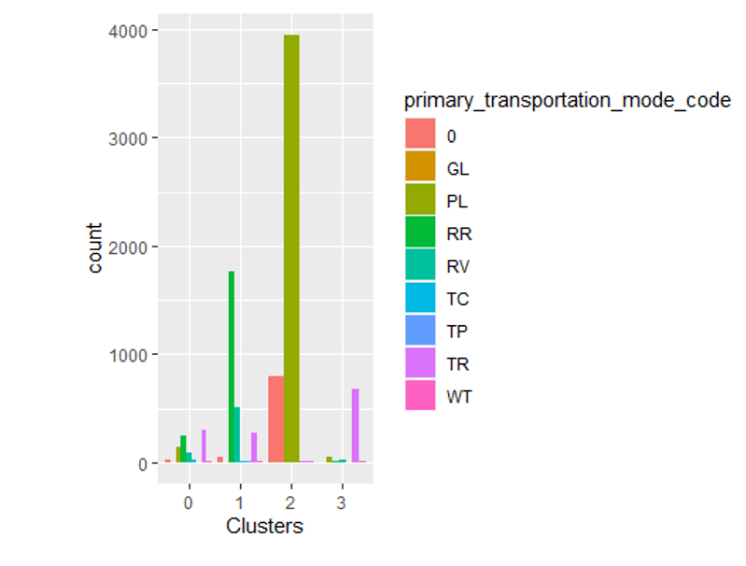
Analysis of Clusters

Slide 12
Conclusion
Based on the clusters created, coal is the fuel that must be excluded from power production.
Coal consumption needs to be reduced urgently to protect it for future generations.
Coal expenditures are much too costly compared to gas and oil.
Instead of excluding the gasoline on which they are spending the least, it is advisable to take into account the fuel on which they are spending the most, especially when that fuel isn't even the best kind.
The government can employ oil, which is available in its purest form and can be used for a variety of reasons, instead of spending a lot of money on coal.

Slide 13
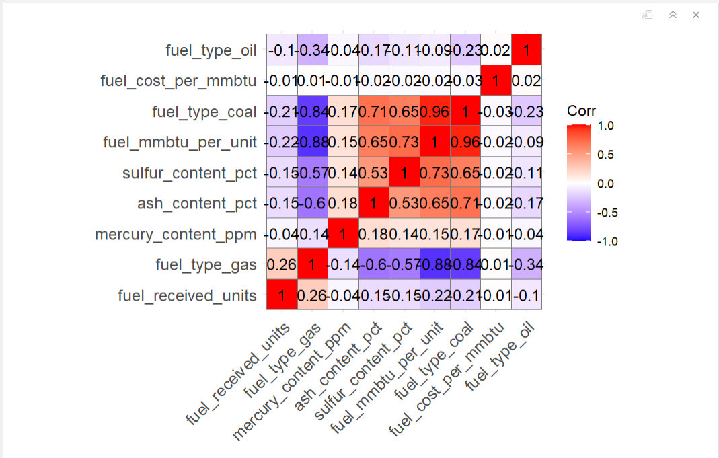

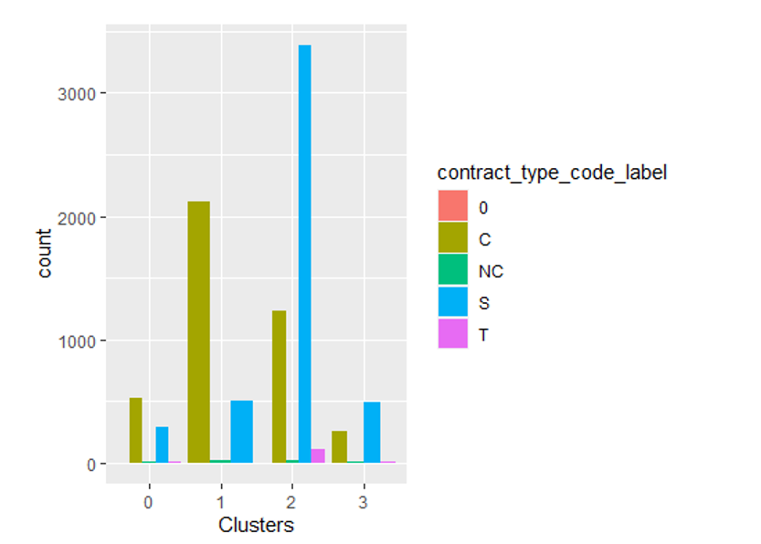
THANK YOU

